Slide 1

Notes:
Hi everyone! Thank you for coming to see us pitch today. We are really excited to present the project we have been working on tirelessly over these past few weeks. We want to thank Arun, James, Rania and Rory for their guidance and their help with getting the data we needed to get started with this project. Without further delay, let's get started.

Slide 2






THE TEAM
Russell Coke
B.S. in Computer Science, Minor in Interactive Media
Front end developer, web-scraping mastermind
Yousra El Hassan
B.S. in Computer Science, Minors in Design & Social Entrepreneurship
Technology & Experience Strategist, obsessive podcast fanatic
Diego Arias
B.A. in Interactive Media, Minors in Visual Arts & Economics
Design strategist, fried dumpling fiend
Ken Iiyoshi
B.S. in Computer Engineering, concentration in Robotics
Futurist, stand up comedy aficionado
Notes:
First of all, I want to introduce you to the team. Russell and Yousra are both Computer Science majors, and they’ve been running point in setting up our platform. Ken, a computer engineer, has been focusing on all of the calculations that happen behind the scenes. I’ll let them tell you more about themselves in a few slides. My name is Diego, and I’m here to introduce you to our work.

Slide 3

85%
Notes:
Did you know that 85% of the fruit and vegetables that we consume in the UAE are imported?

Slide 4
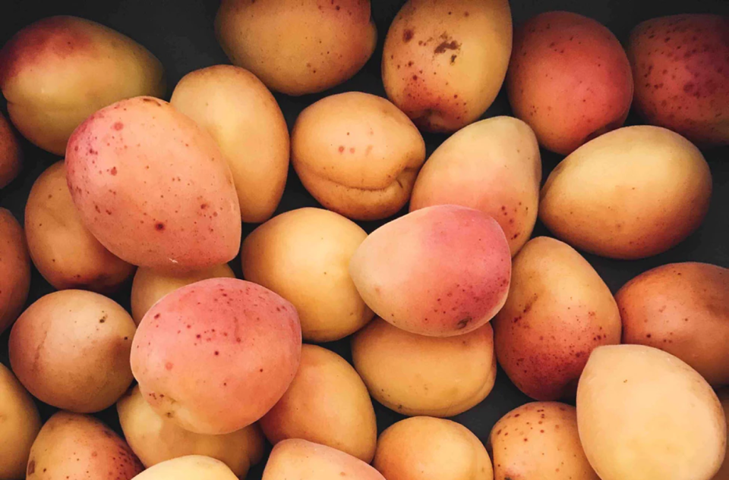
$1
BILLION
Notes:
The market for imported fruits and vegetables, according to the OEC, is $6 billion dollars, out of which 1bn is flown in by air or sea. And that made us wonder, and I’m picking just a particular product here, how did this mango get here? Who farmed it? Who stocked the shelves of my favourite supermarket with hundreds of mangoes? And how could we get Etihad to import EVERY mango into this country?
Through smart partnerships and digitisation, how can we achieve a more effective data input and trend forecasting?

Slide 5

THE OLD WAY
Notes:
And, you know, things have changed. When you think about we used to shop, the old way, you would go to your local market and see things firsthand, that’s not what it is about anymore.

Slide 6
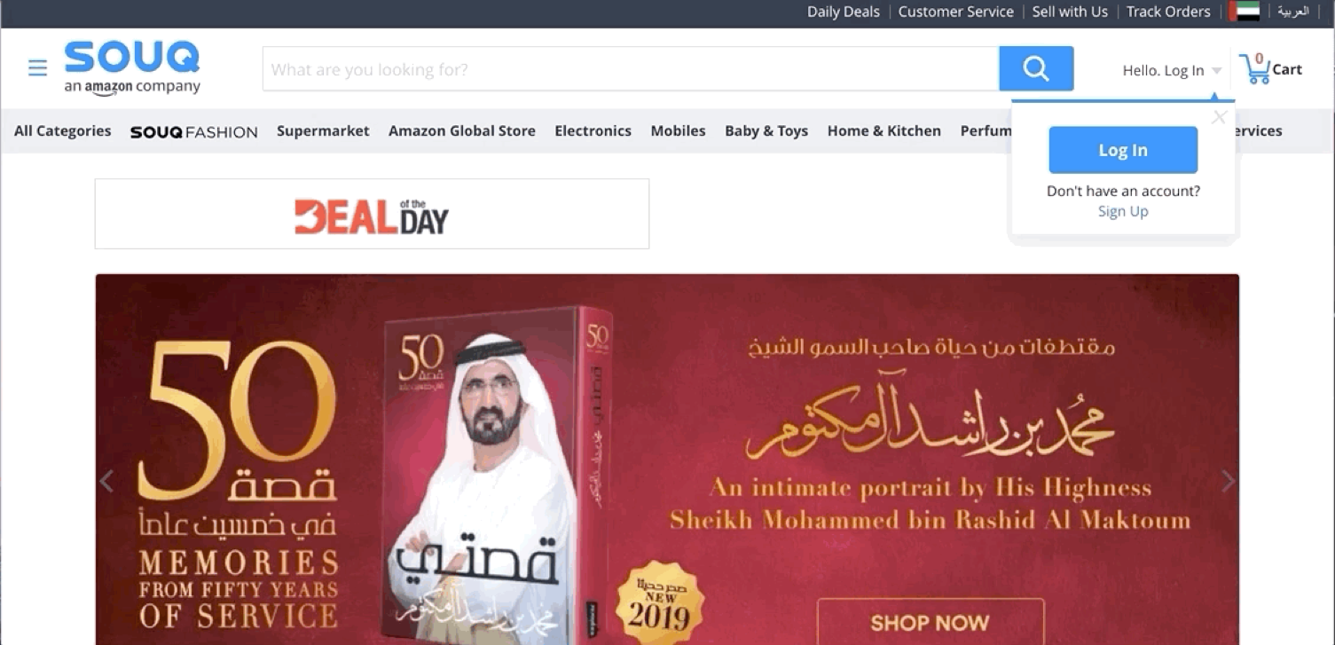
THE NEW
WAY
Notes:
Let’s think about the way people shop nowadays. Let’s talk about e-commerce and globalisation

Slide 7

$5
TRILLION
Worldwide; eMarketer; 2014 to 2017
Notes:
The global ecommerce market - $5 trillion by 2021
What are the particularities of this market?

Slide 8

CUSTOMIZED
Notes:
It’s highly customized.

Slide 9

FAST!
Notes:
Trends change quickly
4 days average delivery time. Amazon, which promises free two-day delivery on millions of products to an estimated 63 million Prime customers in the U.S. The market is unpredictable, and it is extremely difficult to react to its shifts.

Slide 10

THE BIG QUESTION
Notes:
We have an opportunity here:
The digitization of commerce gives us a wealth of information, or data, but how do we turn that into actionable insights?

Slide 11

OUR SOLUTION
Notes:
Our solution is an Ai machine learning platform for business insights that provides the following benefits

Slide 12
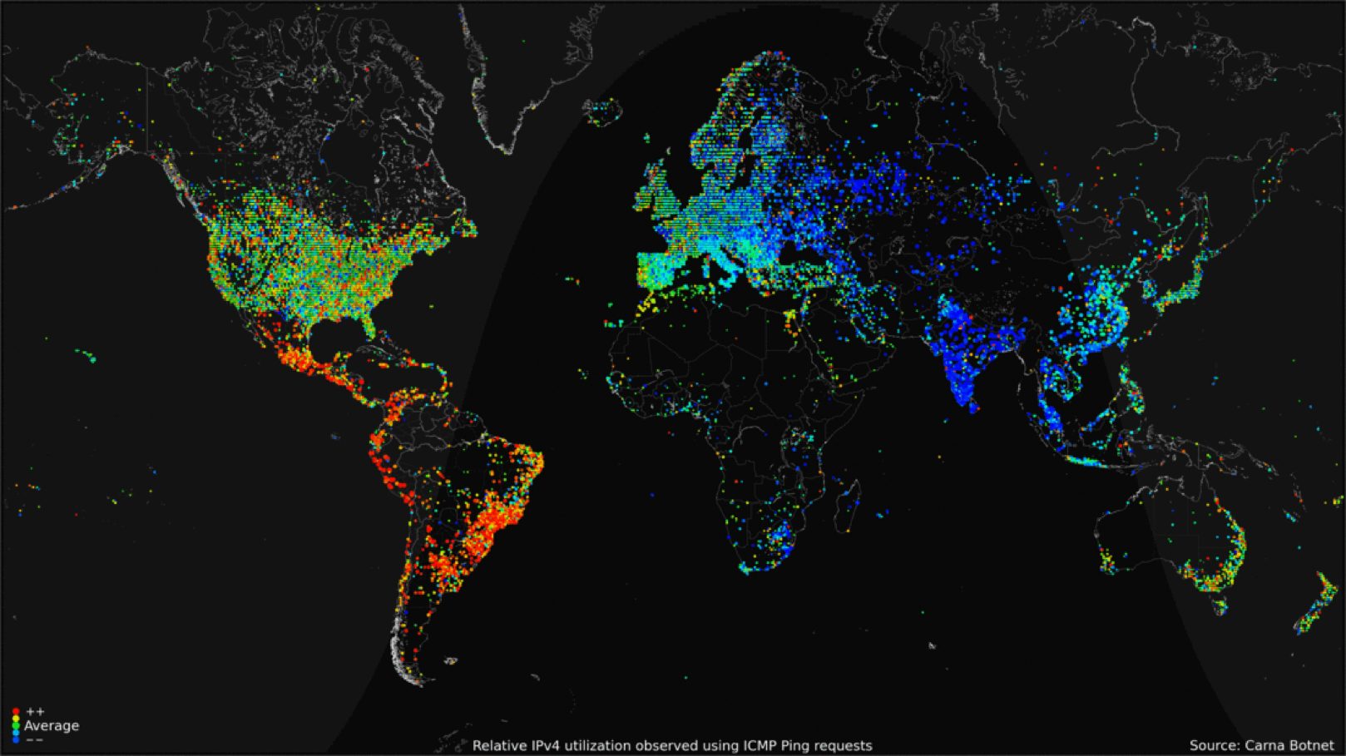
REAL TIME DATA
Notes:
Interactive visualization of real time data such as OIL prices

Slide 13

AI + HUMAN FORECASTING
Notes:
AI powered insights that augment the analysis capabilities of the Etihad Cargo data science teams

Slide 14

Empowering decision making through data visualization and AI-powered insights

Slide 15
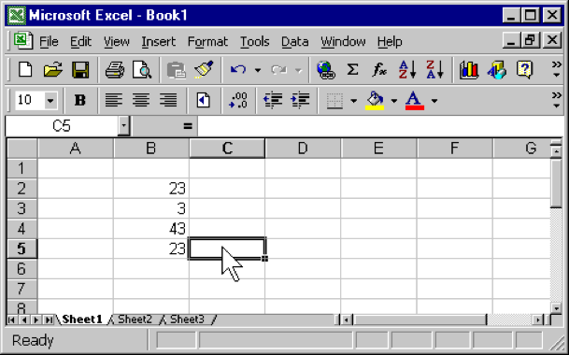

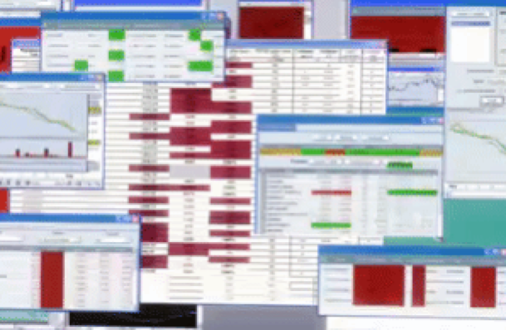

THE OLD WAY
THE NEW WAY
Notes:
This is the old way: cluttered spreadsheets, infinite pivot tables and slow applications
Envision our new way: interactive dashboards that react in real time, dynamic web applications and a wealth of information accessible at your fingertips

Slide 16
TECH DEMO
Notes:
Ken Iiyoshi Live Demonstration Script:
See Appendix 1 for the video:
To make our current dashboard, we were given capacity data of all air routes for 2018 and 2019
We were also given Tonnage of Air Cargoes for 6 anonymous forwarders for 2018.
Currently you can filter by various forwarders, route origin and destination, and simulate revenue at various target rates.
For the time being, we implemented these 4 options but the possibilities are endless as we acquire more data and scale the framework.
The bar graph shows the monthly breakdown of move tonnage and revenue of forwarder 1 from AUH to LAX for 2018.
Next comes the AI-powered insights:
Using 2018 tonnage data and 2019 capacity data. We can forecast the selected forwarder’s top 5 routes for 2019. For example, forwarder 1’s best route is from Frankfurt to Sharjah, with a load factor of 84%.
The remaining insights for AUH to LAX route comes at the bottom.
As shown here, 100% of the tonnage moved on this route was from forwarder 1
Then here, is the forwarder’s moved tonnage on the route in the last year, which in this case is 34.3 tonnes.
Next we have the revenue gained from forwarders 1’s tonnage on this route calculated using the selected target rate
The route’s free space & Forwarder 1’s load factor forecast based on 2019 capacity data.
What-if analysis
Target Rate - let’s say you have a revenue target for the upcoming year, the target rate parameter can be changed to give you an insight on what you need to set the target rate as in order to meet the expectations of the budget
Rise in revenue by raising target rate to 1.8, here there is an over $5000 increase in revenue by changing the target rate to 1.8 from 1.6
Doing the same for AUH to BNE. The map changes to reflect the current route and the data in the dashboard dynamically and instantly updates to reflect the new information
In addition to all of these, we have a real-time visualization of oil price. When we say real-time, we mean that this visual is updated every minute. This visualization can be applied to numerous field, such as precipitation data for mango farms or samsung stock prices or anything to give the company an edge over the competitors

Slide 17
WHAT WILL IT BECOME TOMORROW?
Capacity management
Route optimization
Budget management
Pricing Strategy
Coupled with ACD data & other data sources
Notes:
Tomorrow??

Slide 18
WHY NOW?
Modernizing air cargo
Smart partnerships and innovation
First mover advantage
Strengthening the revenue management system
Notes:
In its February brief, IATA addressed 2 areas of focus for the industry: digitisation & business transformation and innovation. Among the 10 industry priorities, our dashboard can help strengthen the value proposition of air cargo, its strategic partnerships and the modernisation of the industry. The tool would provide Etihad Cargo with an opportunity to be the first ones in the know, granting a first mover advantage that can turn into a temporary monopoly, and lastly, it would impact the Data Input and Forecasting components of an integrated revenue management system, which allows Etihad Cargo to optimise its strategy.

Slide 19



IMPLEMENTATION
2
Scale
Improve
1
3
Expand
Scale
Notes:
data
Algorithms
scale

Slide 20
MANGOES
Notes:
Let’s go back to the mangoes we started with. Following our proposition, if Etihad partnered with an agricultural sensors firm, helped provide sensors to farmers around the world, cultivating strategic partnerships, they would have firsthand access to key data about the state of the mangoes. Using these data insights, you would proactively reach out to stakeholders on every part of the supply chain (farmers, freight forwarders, supermarkets), and together we would beat everyone to market. This is our vision.
The next steps for implementation of the current version would require access to more data, feeding it to the platform and adjusting the algorithms, and making sure it can scale and operate with the data inputs.

Slide 21

THANK YOU
email: nyuad.air@nyu.edu
phone: (+971) 050 821 3909
Notes:
Thank you for your time! We are now open to questions.

Slide 22
APPENDIX I
Video demo
Video Link:https://www.youtube.com/watch?v=nFuWfZ5VsfU&feature=youtu.be
Notes:
Video Link:https://www.youtube.com/watch?v=nFuWfZ5VsfU&feature=youtu.be

Slide 23
APPENDIX II
Tech Stack
Dashboard
Forecasting
Web app
React.js
Python
Flask
Machine Learning
IBM Watson Studio
Python
Pandas
Databases
SQL
PHP

Slide 24
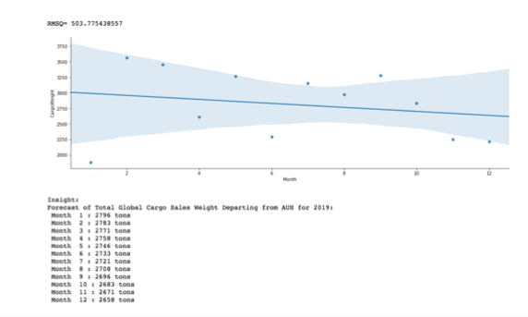
APPENDIX III
Forecasting
Notes:
Forecast Created by Ken Iiyoshi

Slide 25
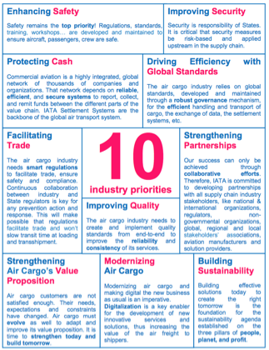

APPENDIX IV
Industry

Slide 26
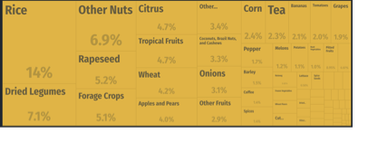
APPENDIX V
Industry
Fresh produce imports in the UAE - Source: OEC (https://atlas.media.mit.edu/en/profile/country/are/)

Slide 27
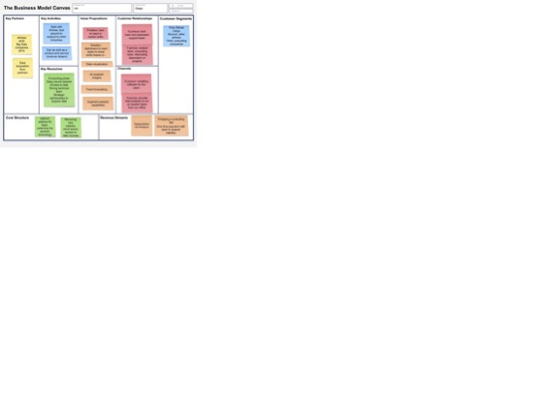
APPENDIX VI
Business model

